Slide 1

Fall 2011 End Of Semester Presentation
DroidHoppers

Slide 2
Agenda
Project Overview
Process
Planning
Requirements
Risk Management
Configuration Management
Team Work
Roadmap for Next Semester
Notes:
This is the agenda
I will cover #1-3

Slide 3
Project Overview
Notes:
20 sec

Slide 4
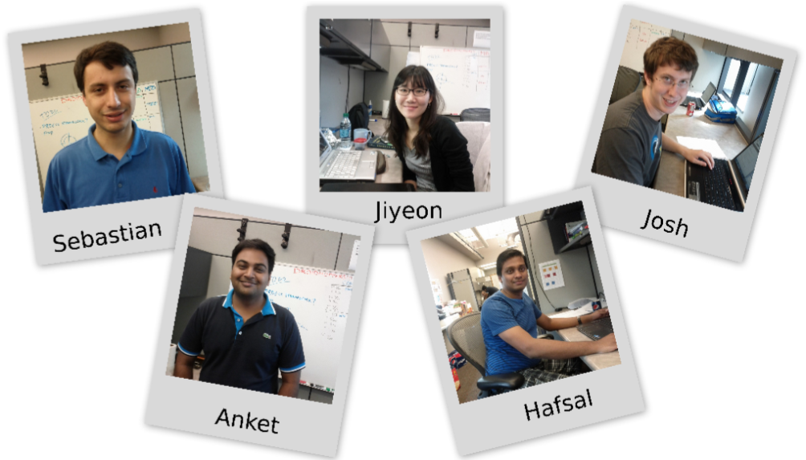





The Team
Overview

Slide 5

Team Mentors
Overview

Slide 6

Customer Profile – G3 Technologies
Overview
Small company located in
Virginia
Provides:
Telecom network analysis
VIP location tracking
Contacts:
Andrew Park (VP of Technology)
Jason Irwin (alternate contact)

Slide 7
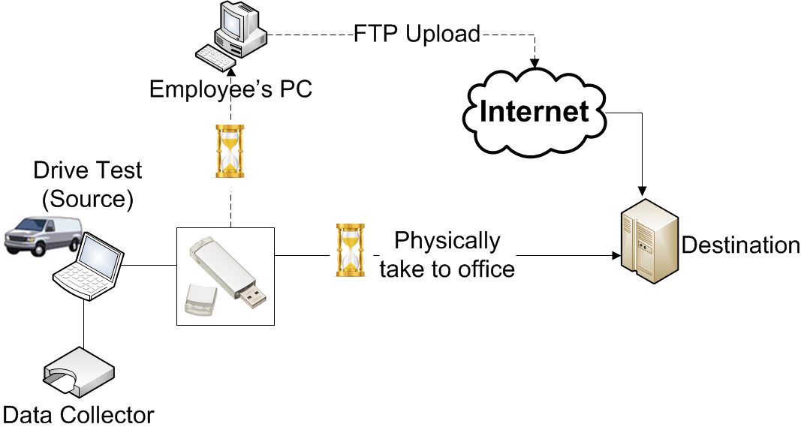
Problem Overview
Overview

Slide 8
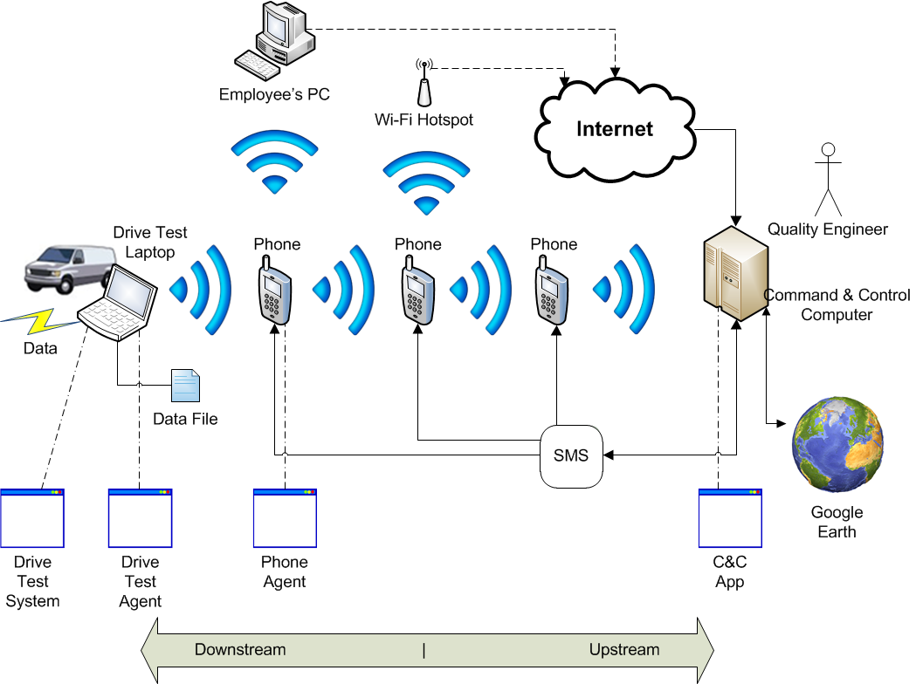
Project Vision
Overview
Notes:
Business Goal:
To offer a cost effective service to their customers in mobile telecommunication industry which will automatically migrate drive test log files from test laptops to their central offices quickly and at zero bandwidth cost.
Project Goal:
Develop, demonstrate and deliver to G3 Technologies a working solution composed of several independent pieces of software, one for each of the devices involved.
This will be the start of a new product offering by G3 Technologies in the future.

Slide 9
PROCESS
Notes:
1:40 gone

Slide 10
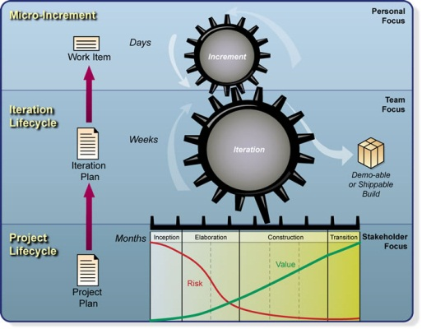
Current Practice
Process
Ad hoc process
Week 1 -9
OpenUP (OUP)
Week 10 onwards

Slide 11


Criteria for Framework Selection
Process
Tailor with ACDM
Criteria | Importance to Project | OUP Meets Need
Traceability | Medium
Architecture | High
Tools | Low
Metrics | Medium
Documentation | Low
Overhead | Low
Risk Control | Medium
Stakeholder Involvement | Medium
Notes:
MAUT - Multi-Attribute Utility Technique

Slide 12
Project Phases
Process
EOSP
MOSP
EOSP
Poster
EOSP
November
January
March
May
July
September
November
Start
Inception Phase
Elaboration Phase
Construction Phase
Transition Phase
Finish

Slide 13
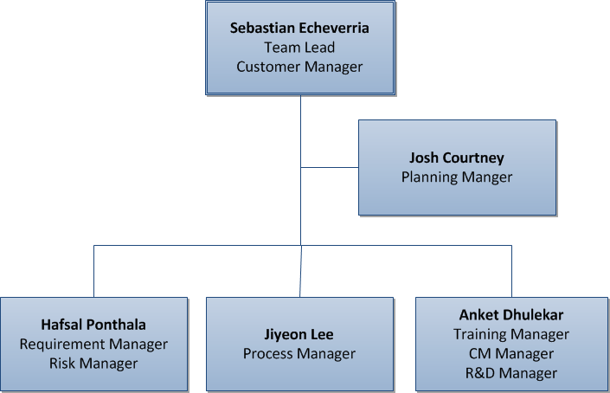
Roles Tailored for OUP
Process
Notes:
We came up with own roles
Those roles mapped well to OUP

Slide 14
Retrospective Meeting
Process
Discovered issues across all project areas
Generated 31 action items for process improvement
Addressed 27 of those issues
Notes:
Ex.
Exit criteria
Checkpoint
Planning checklists

Slide 15
Lessons Learned
Process
Process framework gives us a ‘big picture’ for planning
Roles need a defined purpose
Process must be tailored to fit our needs
Notes:
Shows us what to do in the future so we know what to do to get there

Slide 16
Future Improvements
Process
Tailor OUP architecture process with ACDM
Rotate roles to gain different perspectives and experiences
Continue improving via the retrospective process
Create new role: EOSP Watcher

Slide 17
Planning
Notes:
4:30 gone

Slide 18
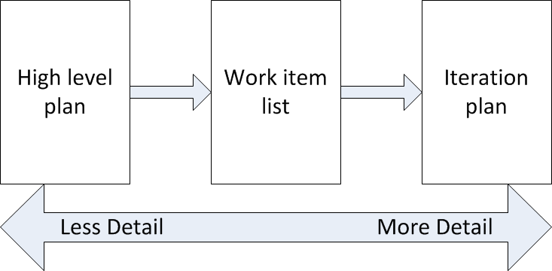
Current Practice
Planning
Notes:
Broad high-level plan – schedule for entire program
Phase task planning and estimation – tasks and estimations for current semester
3) Iteration task detail and refinement – exit criteria, refined estimations, work assignments bi-weekly

Slide 19
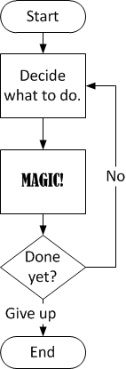
Lack of a Plan
Planning
Notes:
Weekly status meetings
Action item assignments

Slide 20
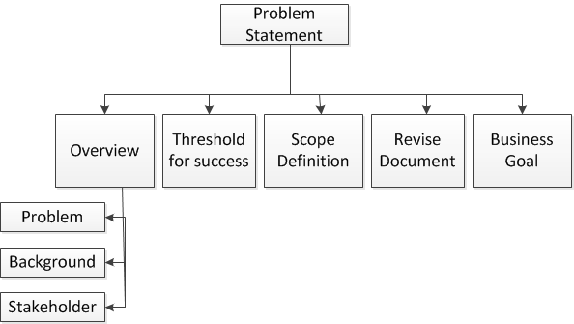
Plan ALL the Things
Planning
Notes:
WBS for first semester
Attempted to define and assign all tasks
Timesheet time tracking
Wideband Delphi
WBS proposal saying we would define every single task using this WBS.
Tasks defined were too high level
Timesheet ran from Wednesday to Wednesday. It was worthless

Slide 21
High Level Plan
Planning
Milestone | Date
Statement of Work signed | 2011/12/15
Architecture baselined | 2012/02/24
Transfer framework complete | 2012/04/13
Requirements frozen | 2012/04/13
Command and Control module feature complete | 2012/06/29
All code feature complete | 2012/07/13
Initial operational capability (code complete) | 2012/08/03
Project delivered (code and documentation) | 2012/10/19
Poster session | 2012/11/16
Notes:
Transfer in elaboration
Construction before summer

Slide 22
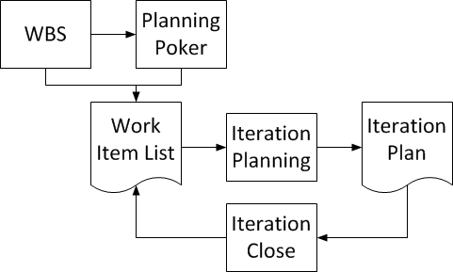
Planning with OUP
Planning
Notes:
Phase planning with new WBS from high level plan
Used OUP artifacts to guide breakdown
Used Wideband Delphi estimates where appropriate
Planning poker for other estimation
Mention task list
WBS is throwaway

Slide 23
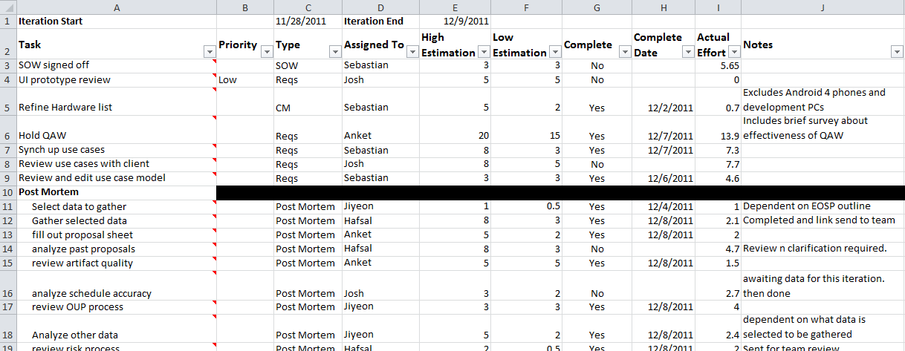
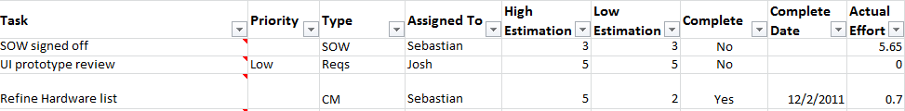
Iteration Planning
Planning
Notes:
Buffer tasks are difference between budget and low estimate.
Informal task assignment
All tasks given exit criteria – added later
From iteration 3

Slide 24
Iteration Planning Cont.
Planning
Percentage
of total tasks
Notes:
Pull tasks from task list based on high level plan
Divide tasks that are too big
High estimate can require overtime
Low estimate does not cause overtime

Slide 25
Lessons Learned
Planning
You can’t plan every detail
Planning poker has been our most effective estimation technique
Time tracking must be consistent
Planning and plan tracking should be continuously improved

Slide 26
Future Improvements
Planning
Use Work Item List better
Find trends in estimation
Refine estimation practice
Modify for continued overestimations
Shorten planning meetings
Reduce from 1.5 hr. to 1 hr.
Notes:
Use of task sheet is spotty. We’re in the process of using it more
Currently overestimating -38% percentage of error

Slide 27
Plan Execution and Monitoring
Notes:
8:40 min gone

Slide 28
Current Plan Execution Practice
Planning
Each task is assigned an owner
Each task has defined exit criteria
All work is tracked with 0.1 hr. precision
Metrics are tracked using iteration plan
Notes:
Each task is assigned a responsible person
Closed tasks are checked against exit criteria
All work is tracked with .1hr precision
Metrics are tracked using iteration plan

Slide 29
Starting Out
Planning
Notes:
Tasks on Zoho
People didn’t check their tasks after meetings
Tasks were not clearly defined
Useful work was executed in meetings
- one third of Sept. ZOHO tasks were to schedule meetings same as iteration 3
- PMP was useful for driving meeting discussions but not helpful long term

Slide 30
Starting Out
Planning
Hours
Weeks
Notes:
Low Execution of hours
Average is 44 hrs

Slide 31
With High Level Plan
Planning
Hours
Weeks
Notes:
Better average executed hours 60.5 over 44
A lot of work driven by bootcamp (week 7)
People didn’t check their tasks after meetings
Tasks were not clearly defined

Slide 32
With OUP
Planning
Hours
Weeks
Notes:
62 avg hours per week
66 if you exclude thanksgiving (42 hours).

Slide 33
Current Metrics
Planning
Hours
Dates
Notes:
Earned Value with burndown chart
Shown chart from third iteration
Shows student syndrome and inconsistent work.
Other metrics:
Estimated vs. actual work distribution
Team and individual hours executed

Slide 34
Lessons Learned
Planning
People have different interpretations of “done”
People need motivation to finish all their tasks
Not all metrics are clear or useful

Slide 35
Future Improvements
Planning
Add checkpoint system
Prevent student syndrome
Revamp iteration analysis
Eliminate confusing metrics
Evaluate work distribution charts
Examine for replacement

Slide 36
REQUIREMENTS ELICITATION (RE)
Notes:
12:00 gone 13:00 ok

Slide 37
Current Practice
Requirement
Query log
Requirement-related questions
Customer responses
Use cases
Functional requirements
Method for customer walkthrough
QAW
Quality attribute clarifications
Notes:
Explain Query Log : Excel sheet now list in sharepoint
Walkthrough

Slide 38
RE Stats
Requirement
5 RE sessions with customer
9/9
10/7
10/20
11/11
11/29
Oct
Nov
Dec
56 Closed Queries
3 Open Queries
59 items in Query log
Query log status
14 high level use cases reviewed with customer
1 major change
7 minor clarifications
Notes:
5 sessions
Reqs validated using pictures and text.
Client actually read text

Slide 39
Quality Attribute Workshop (QAW)
Requirement
8 high-priority scenarios
4 medium-priority scenarios
5 out of the 12 scenarios were driven by team members
7 out of the 12 scenarios were driven by Felix from SEI
Notes:
Felix led the workshop
Counts
Team did 5
Useful and customer gave rating of 3 but happy

Slide 40
Lessons Learned
Requirement
WHAT is often confused with HOW
Query log is a better option than consolidating customer emails
Visuals improve communication with customer
We could now hold a QAW without outside help
Notes:
Customer required visuals did not like wordy documents

Slide 41
Future Improvements
Requirement
Improve meetings with customer
Practice with team
Measure effectiveness of the requirements
Addition/modifications to requirements (stability)
Used/not used requirements
Use more visuals when communicating with customer

Slide 42
Risk Management
Notes:
15:30

Slide 43
Current Practice
Risks
Weekly risk review (identification/assessment)
Risk Management Log (RML)
Risk mitigation tasks as part of iteration tasks

Slide 44

Risk Identification
Risks
RML

Slide 45
Top Three Risks
Risks
Risk 1: Current Android technology is not well known; proposed solution with that technology will not work.
Risk 2: No deadline for receiving hardware/software from client; plan will be delayed.
Risk 3: Release date of new Android phones with 4.0 is unknown; request for hardware from customer will be delayed.

Slide 46
Current Risk Management Process
Risks
Identify
Prioritize
Plan for mitigation
Track and monitor
Assess
Communication

Slide 47
Risk Stats
Risks
8 Monitored
5 Open
19 Total
6 Closed
Notes:
2 risks moved from open to monitor status
Risk impacts and occurrence of 5 risks has been changed during assessment

Slide 48
Risk Management Efficiency
Risks
Risks that became problems: 0
Risks that were effectively mitigated: 3
Total percentage of time used for risk management in each iteration: 2%
Risk occurrence lowered
Risk impact lowered

Slide 49
Lessons Learned
Risks
It is easy to forget about mitigating the risks
Plan for mitigation tasks in each iteration
Monitor top risks regularly
Proactively monitoring risks was a challenge
Setup reminders
Risks discussed during planning and mentor meetings

Slide 50
Future Improvements
Risks
Include timeframe for risks in RML
Define mitigation and contingency strategies for all monitored risks
Rank risks during start of new phase

Slide 51
Configuration Management
Notes:
19:00

Slide 52






Current Practice
CM
SharePoint for document management
Google Calendar for meeting scheduling
Toggl for time recording
Document templates for standardization
Naming standards for document organization
toggl
Notes:
MS SharePoint
Excel sheet task tracking
All documents stored in one place
All documents have version history

Slide 53
Lessons Learned
CM
Artifacts should be kept in one place
We have to make sure we have enough storage space
Versioning tool benefits outweigh setup costs

Slide 54
Future Improvements
CM
Enable check-in/check-out for documents
Improve version control
Set up source code version control
Analyze customer’s preferred tools
Automate backups
Prevent potential data loss

Slide 55
Team Work
Notes:
21:00 gone

Slide 56
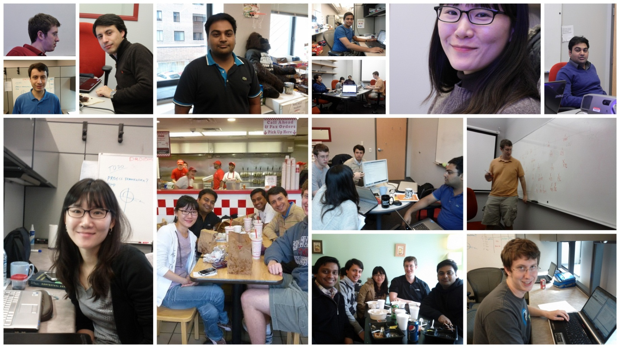
Team Work
Team Work
Notes:
Natural blend
Personal goals mapped to Project Goals

Slide 57


Team Activities
Team Work
Sep
Oct
Nov
Dec
Learn a new word every week in Spanish, Hindi and Korean

Slide 58
Team Work
Team Work
Client’s feedback on team’s performance

Slide 59
Roadmap for next semester
Notes:
23:00 Gone

Slide 60
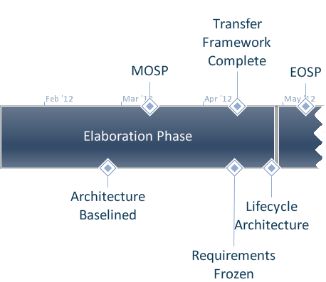
Roadmap for Next Semester
Roadmap
Notes:
ACDM iterations
Transfer framework

Slide 61
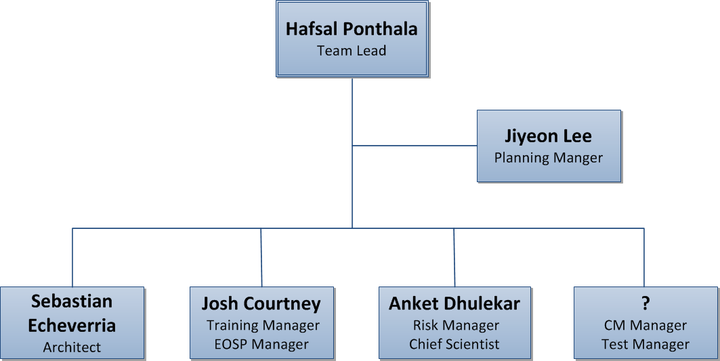
Roles for Next Semester
Roadmap

Slide 62
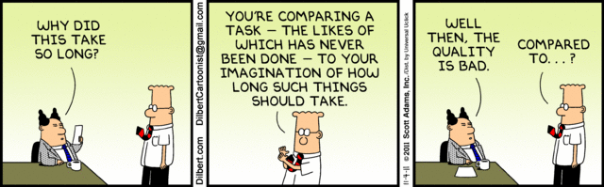
Q & A
धन्यवाद
“Dhanyavaad”
감사합니다
“Kamsamnida”
Gracias
Thank you

Slide 63
Backup project overview

Slide 64
Business Goal
To offer a cost effective service to their customers in mobile telecommunication industry which will automatically migrate drive test log files from test laptops to their central offices quickly and at zero bandwidth cost.

Slide 65
Project Goal
Develop, demonstrate and deliver to G3 Technologies a working solution composed of several independent pieces of software, one for each of the devices involved.
This will be the start of a new product offering by G3 Technologies in the future.

Slide 66
Success Criteria
The team will demonstrate the system automatically sending a data file generated in the drive test laptop to a computer in the central offices, without using cellular network bandwidth, in a test scenario.
The team will demonstrate the system showing the location of different data files
The system will fulfill the high importance quality attributes described in the QA Scenarios document.
The team will deliver the indicated deliverables in the established dates (see section below).

Slide 67
Backup process

Slide 68
MAUT
Criteria | Weight (W) | RUP |  | AUP |  | OUP
Traceability | 3 | 5 | 15 | 3 | 9 | 5 | 15
Architecture | 9 | 0 | 0 | 0 | 0 | 0 | 0
Tools | 3 | 5 | 15 | 3 | 9 | 4 | 12
Metrics | 9 | 7 | 63 | 5 | 45 | 5 | 45
Documentation | 3 | 5 | 15 | 7 | 21 | 9 | 27
Lack of Overhead | 7 | 1 | 7 | 7 | 49 | 5 | 35
Risk Control | 5 | 7 | 35 | 5 | 25 | 5 | 25
Stakeholder Involvement | 5 | 7 | 35 | 5 | 25 | 7 | 35
Total |  |  | 185 |  | 183 |  | 194

Slide 69
Is it helping us?

Slide 70
Roles and Responsibilities
Planning Manager | Lead project plan and iteration plan meetings Allocate work items from iteration plan Schedule status meeting and prepare agenda | Josh
Risk Manager | Lead risk identification, analysis, tracking and control Create and monitor risk mitigation actions Lead risk management meeting Keep team updated with all the risks | Hafsal
Process Manager | Lead process framework selection Monitor whether the process needs to be tailored | Jiyeon
Training Manager | Plan and schedule training Execute training Evaluate training | Anket
Configuration Manager | Setup document & code standard Setup archive & backup Setup version control Setup configuration tool | Anket
Scribe | Note and upload MOM Finalize MOM Allocate action items from meetings Send MOM to all including mentors | All
Team Lead | Verify that team is doing its job Coordinate between team members Communicate with external individuals (mentors, faculty, customers, etc.) Lead general meetings and prepare agenda Schedule and lead client meeting Lead iteration retrospective meeting | Sebastian

Slide 71
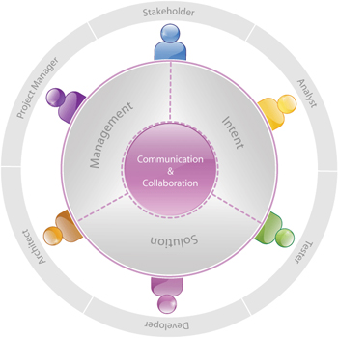
Open UP Roles

Slide 72
Backup planning

Slide 73
Task List Sample
ID | Task description | Min Estimate (hr) | Max Estimate (hr) | State | Iteration | Effort Spent (hr) | Assumptions
 | No category tasks
1 | Write Milestone/Timeline for SOW | 1 | 3 | Complete | 2 | 0.4 | Writing from scratch, Quick discussion with no formal review
2 | Review Milestone/Timeline for SOW | 0.5 | 2 |  |  |  | Quick team discussion, formal review
3 | Setup project plan | 13 | 20
4 | Customize Templates | 4 | 4 | Complete | 1 | 4.3
5 | Write stakeholders responsibilities
6 | Review stakeholders responsibilities | 0.5 | 3 | Complete | 2 | 0.3 | No meetings
7 | Edit Problem statement | 2.5 | 5 | Complete | 2 | 0.5 | Mentor feedbacks not considered
8 | integrate Problem statement | 0.5 | 2 | Complete | 2 | 0.3 | Minor editing, minor review

Slide 74
Wideband Delphi Estimation
Hours
Estimation Round
Notes:
Estimated Durations using wideband Delphi technique.
Tasks taken from WBS

Slide 75
Hours Data
Week | Hours
1 | 31
2 | 48
3 | 47
4 | 43
5 | 51
Avg. | 44
Week | Hours
6 | 54
7 | 75
8 | 51
9 | 61
Avg. | 60.25
Week | Hours
10 | 78
11 | 58
12 | 58
13 | 42
14 | 54
15 | 82
Avg. | 62
Avg. - TG | 66
Notes:
Weekly status meetings
Action item assignments
Unable to execute 60 hours

Slide 76
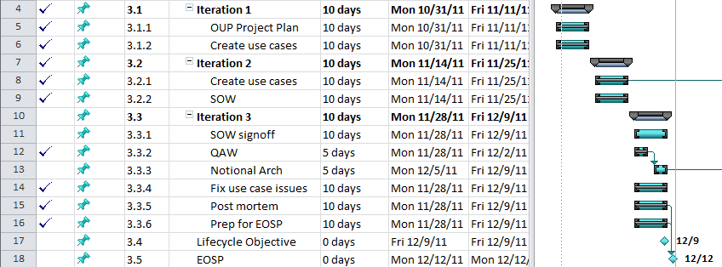
High-Level Plan Sample

Slide 77
Iteration Plan Metrics
Notes:
Iteration 3

Slide 78
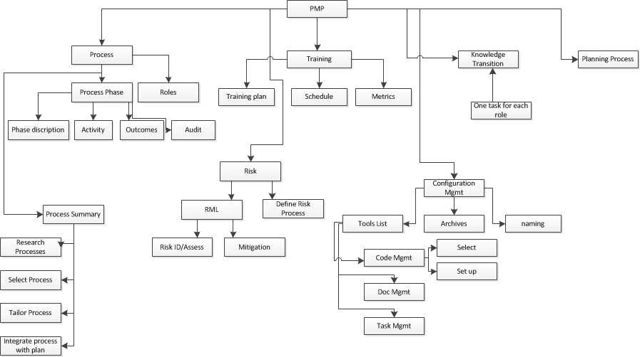
Bad WBS Sample
Notes:
Post Mortem, PMP, Problem statement, rec doc

Slide 79
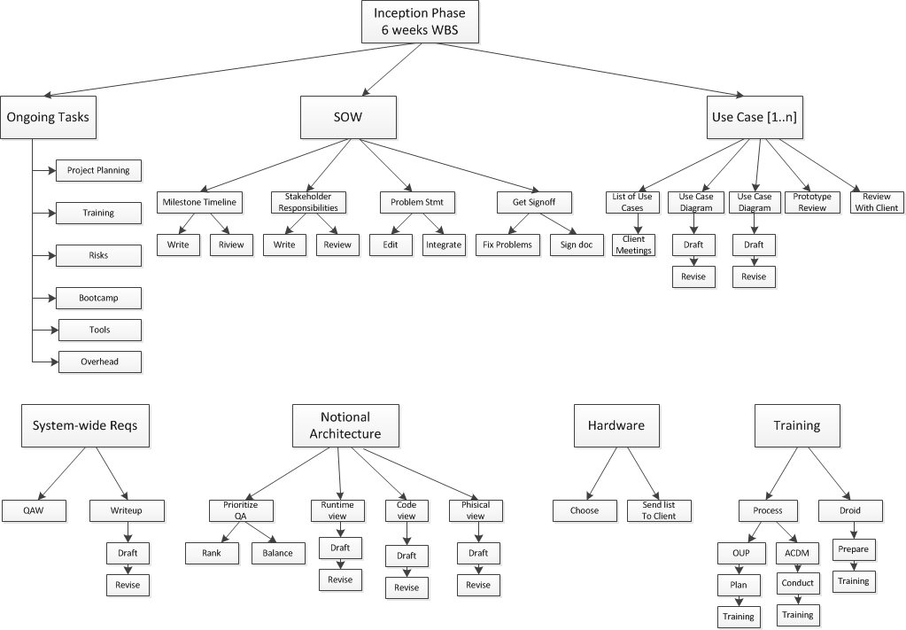
Better WBS Sample

Slide 80
Wideband Delphi Sample
Task | SE | AD | HP | JE | JC | Max | Min | Avg - max,min | Pure Average
Post Mortem | 96 | 161 | 59 | 72 | 79 | 171 | 36 | 86 | 95
Analyze data | 25 | 40 | 24 | 12 | 38 | 40 | 12 | 29 | 28
collect proposals | 3 | 10 | 2 | 2 | 1 | 10 | 1 | 2 | 4
analyze proposals | 8 | 20 | 4 | 15 | 12 | 20 | 4 | 12 | 12
review artifact quality | 15 | 30 | 12 | 10 | 13 | 30 | 10 | 13 | 16
review schedule | 10 | 16 | 4 | 10 | 3 | 16 | 3 | 8 | 9
review process | 15 | 35 | 5 | 7 | 8 | 35 | 5 | 10 | 14
review exit criteria | 10 | 10 | 4 | 8 | 1 | 10 | 1 | 7 | 7
suggest process improvements | 10 | 0 | 4 | 8 | 3 | 10 | 0 | 5 | 5
EOSP | 32 | 65 | 23 | 43 | 35 | 70 | 21 | 35 | 39
Write Powerpoint | 15 | 15 | 12 | 20 | 10 | 20 | 10 | 14 | 14
Plan presentation | 13 | 40 | 8 | 18 | 15 | 40 | 8 | 15 | 19
Practice presentation | 4 | 10 | 3 | 5 | 10 | 10 | 3 | 6 | 6
TOTAL | 380 | 536 | 481 | 336 | 404 | 810.5 | 182 | 380 | 430

Slide 81
EV Data
 | Total Hi/Low Estimate | Task Hi/Low Estimate | Total Actual | Task Actual | Velocity | Focus Factor
Iteration 1 | 155 | 90 | 94.4 | 37.4 | 61.5 | 51%
 | 115.5 | 50.5
Iteration 2 | 183 | 135 | 86.3 | 21.7 | 63.6 | 53%
 | 121 | 72
Iteration 3 | 238 | 169 | 111 | 70 | 78 | 65%
 | 134 | 95.5

Slide 82
Proof of Overestimation
 | High | Low | Good | TOTAL
Iteration 1 | 2 | 10 | 5 | 17
Iteration 2 | 1 | 20 | 2 | 23
Iteration 3 | 3 | 5 | 10 | 18
 | Underestimate | Overestimate | Within Range
Iteration 1 | 12% | 59% | 29%
Iteration 2 | 4% | 87% | 9%
Iteration 3 | 17% | 28% | 56%

Slide 83
Are Estimations Improving?
 | Average Estimated Effort | Actual Effort | Percentage of Error
Iteration 1 | 135.25 | 94.4 | -30%
Iteration 2 | 152 | 86.3 | -43%
Iteration 3 | 186 | 111 | -40%

Slide 84
Sample Iteration Plan Metrics
Notes:
New version – work in progress

Slide 85
Backup requirements

Slide 86
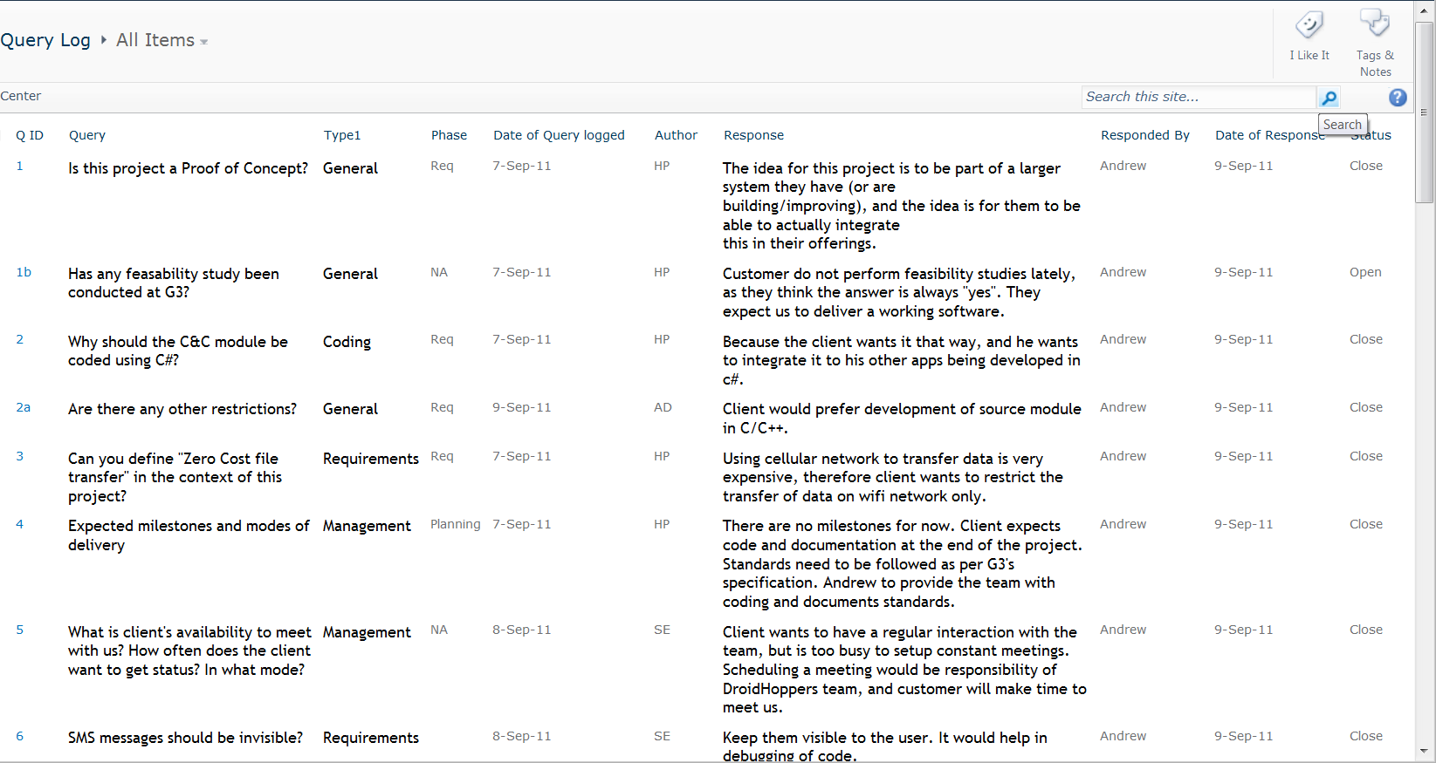
Query Log Screen Shot
Notes:
MS SharePoint
Excel sheet task tracking
All documents stored in one place
All documents have version history

Slide 87
Quality Attribute Workshop (QAW)
High
Continuous Data Collection
Accountability (Reliability of device responding)
Data Accuracy
Configurability (Availability of device with new configuration)
Configurability (Performance of device with new configuration)
Maintainability (Documentation)
Maintainability (Code Readability)
Robustness
Medium
Accountability (Data cannot be erased)
Accountability (Historic Data kept for required timespan)
Turn Around Time
Security
8
4
Notes:
Continuous Data Collection
Accountability (Reliability of device responding)
Data Accuracy
Configurability (Availability of device with new configuration)
Configurability (Performance of device with new configuration)
Maintainability (Documentation)
Maintainability (Code Readability)
Robustness
Accountability (Data cannot be erased)
Accountability (Historic Data kept for required timespan)
Turn Around Time
Security

Slide 88
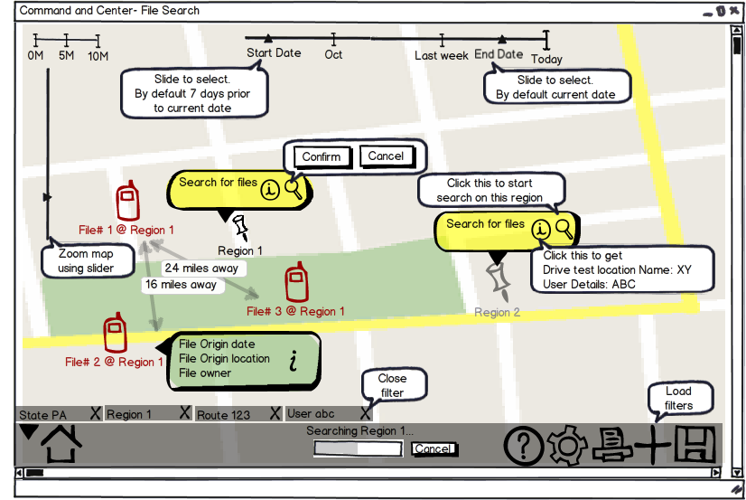
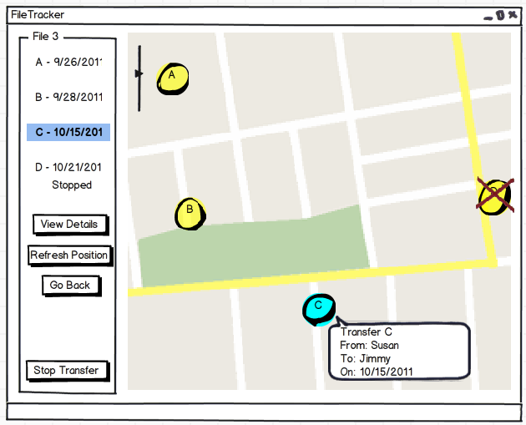
UI Prototype
Prepared 4 UI prototype for the Command & control
Prototype prepared as part Methods course assignment
Customer review pending
Notes:
Good:
Tied documents to meetings
Task tracking
Bad
Small storage limit (10 MB)
Duplicated documents and schedule tracking
Tasks and action items combined

Slide 89
Preciseness of Requirements
Quality Attributes | Scenario
Continuous data collection | Trigger: A data file is finished creating in the source directory. Response:The file is marked for transfer and is uploaded when a connection becomes available. Measure:The transfer is done in at least 99.99% of the cases. Environment:The availability of the connection can happen at any point in time.
Accountability | Trigger: A quality engineer requests the information collected. Response: The device receives the request and responds with information about available files. Measure: In 99.9% of the request. Environment: Transferred via SMS
Data transfer quickly using Wi-Fi | Trigger: A Wi-Fi connection has been established. Response: The file is transfer is started from the downstream device to the upstream device Measure: starts within 10 seconds of being in range of each other devices and using less than 5% transfer overhead.
For Quality Attributes

Slide 90
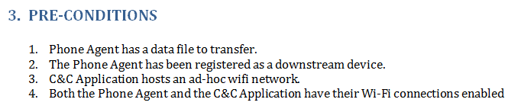
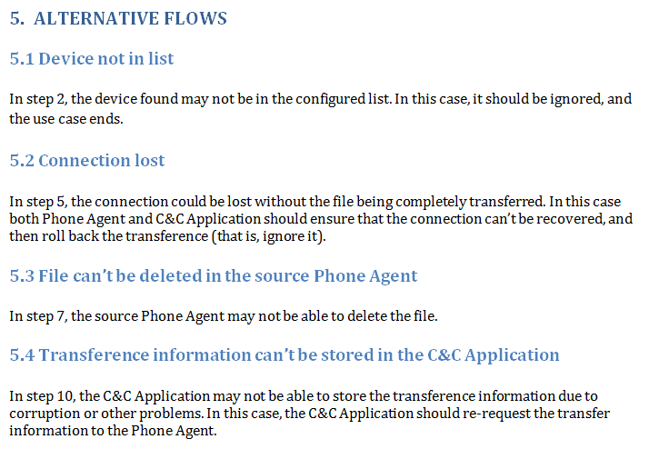
Preciseness of Requirements
For functional requirements

Slide 91
Use Case Peer Review Effectiveness
Use cases | Number of changes | Type of changes
UCS001 | 1 | Minor
UCS002 | 2 | Minor
UCS003 | 2 | Minor
UCS004 | 2 | Moderate
UCS005 | 1 | Minor
UCS006 | 1 | Minor
UCS007 | 1 | Minor
UCS008 | 2 | Minor
UCS009 | 2 | Moderate
UCS010 | 2 | Moderate
UCS011 | 2 | Moderate
UCS012 | 3 | Major
UCS013 | 2 | Major
UCS014 | 1 | Minor
UCS015 | 1 | Minor
LEGEND
Major | Related to complete change in basic flow
Moderate | Related to minor change in basic flow
Minor | Change in wordings

Slide 92
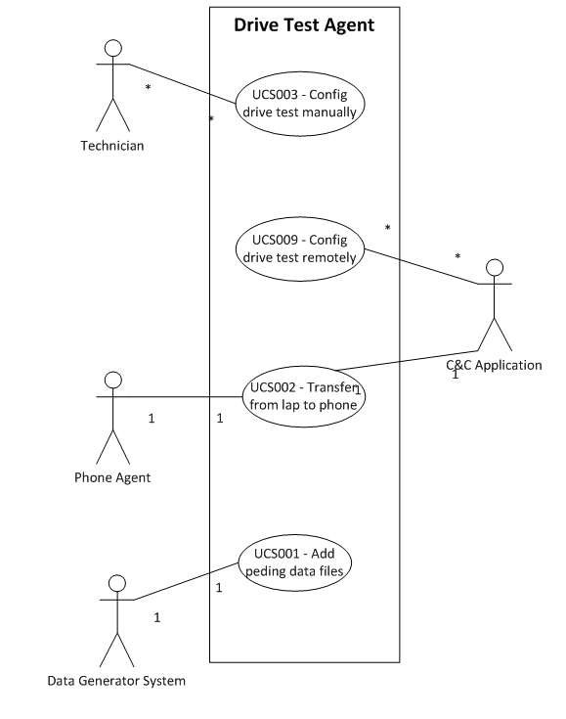
Example Use Case Model
Notes:
MS SharePoint
Excel sheet task tracking
All documents stored in one place
All documents have version history

Slide 93
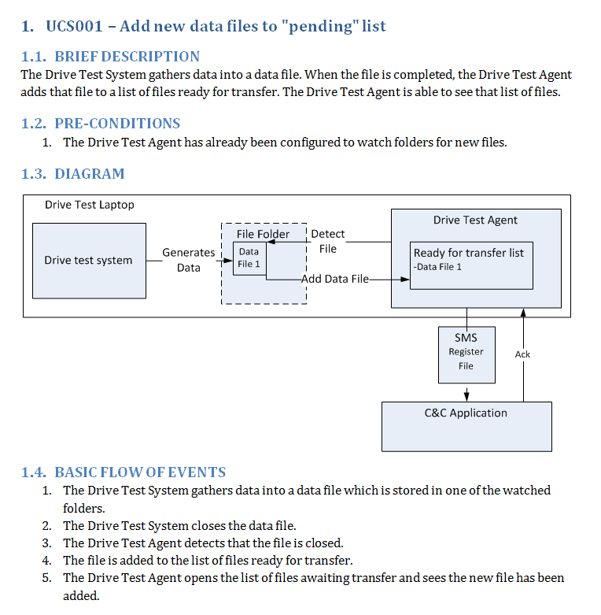
Use Case Screen Shot
Overview diagram for the basic flow
Notes:
MS SharePoint
Excel sheet task tracking
All documents stored in one place
All documents have version history

Slide 94
Backup risks management

Slide 95





Risk Watchers
Risks
Team Member #1
Team Member #5
Monitored Risk #1
…
Monitored Risk #5
Risks reviewed once in a month
Risk watchers did not work for us;
Everyone was not aware of all risks
Continuous monitoring was based on each risk watcher’s feedback.

Slide 96
Currently Monitored Risks
ID | Current Status | Risk Impact | Probability of Occurrence | Risk Map | Risk Description
1 | Monitor | High | Low | Yellow | Inadequate planning; Inability to plan and schedule the project.
11 | Monitor | High | Medium | Red | Current android technology is not well known; proposed solution with that technology will not work.
3 | Monitor | Low | Medium | Green | No access to end-user of the current system; product may not meet the end-users need.
4 | Monitor | Medium | Low | Green | Partial availability of the customer; time delay in requirement gathering.
5 | Monitor | Medium | HIgh | Red | No deadline for receiving hardware/software from client; Plan will be delayed.
16 | Monitor | Medium | Low | Green | Lack of preparation for EOSP; poor performance for EOSP
17 | Monitor | Medium | High | Red | Release date of new android phones with 4.0 is unknown; request for hardware from customer will be delayed
18 | Monitor | Medium | Medium | Yellow | New or unknown issues with new version of android 4.0; Delay to complete the project

Slide 97
Risk Management Log (RML)
Risk identification number
Open
Monitor
Close
High
Medium
Low
Description of the impact
ID | Current Status | Risk Impact | Probability of Occurrence | Risk Map | Risk Description | Project Impact
High
Medium
Low
Red
Yellow
Green
Cause; Consequences

Slide 98
RML More (edit)
Risk Area | Symptoms | Triggers | Risk Response Strategy | Response Strategy
Contingency Plan | Risk Watcher | Risk Identification Date | Risk Close Date | Reason for closing

Slide 99
Backup cM

Slide 100


CM evolution
Notes:
MS SharePoint
Excel sheet task tracking
All documents stored in one place
All documents have version history

Slide 101
Google Docs
Notes:
Good:
Simultaneous editing
Automatic version control
Bad:
Documents tied to account of creator
Not all documents shared
Occasional formatting issues
Some documents lost in email hell
98 in email. H=8 a=1 Ji=3 DH=13

Slide 102
Benefit Analysis for Project Change
Good
Bad
High spirited team
Reusable process
More value for the client
Loss of 640 Studio hours
Would take 7 weeks to catch up
Less remaining time to finish project
Decision
If there is no catastrophic reason then team would not like to change the project
Notes:
MS SharePoint
Excel sheet task tracking
All documents stored in one place
All documents have version history

Slide 103
Benefit Analysis for Project Change
Total studio hours for 12 weeks: 640 hours
= (6.25 + 9.666667 + 9.458333 + 8.5 + 10.166667 + 10.85 + 15 + 10.116667
+ 12.2 + 12.75 + 11.55 + 11.633333) x 5
Time utilized for project:
= Total hours – Time spent in Bootcamp
= 512 hours
Time spent in two iterations:
= Time spent in iteration 1 + Time spent in iteration 2
= 70 + 50
= 120 hours
Notes:
MS SharePoint
Excel sheet task tracking
All documents stored in one place
All documents have version history

Slide 104
Benefit Analysis for Project Change
Time spent on project before OUP adoption:
= Total time spent on project – Time spent in two iterations
= 512 – 120
= 392 hours
Effective time spent before OUP adoption:
= 50% of 392
= 200 hours (approx)
Number of total hours lost:
= Effective time spent before process adoption + Time spent in two iterations
= 200 + 120
= 320 hours = 7 weeks of work
Notes:
MS SharePoint
Excel sheet task tracking
All documents stored in one place
All documents have version history

